Slide 1
who am I?
In a nutshell, I...

Slide 2
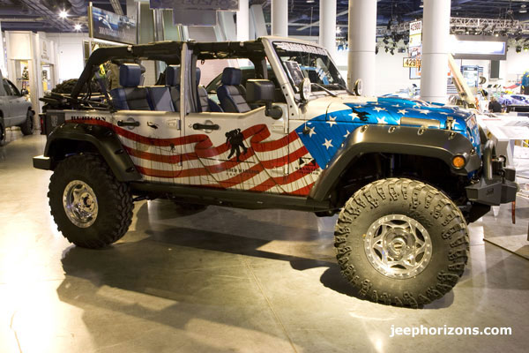
the basics:
-have been in Rhode Island for the past 8 years, and East Greenwich the past 7 years…

Slide 3
And as you can tell…
-I kind of like big trucks, including trucks from Monster Jam (and yes, I have been to a few Monster Jam events)

Slide 4
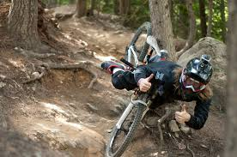
Other things I like:
-home made tamales
-Sushi
-Silver Spoon Bakery cake-pops
-Big Bang Theory, American
Ninja Warrior
-Boating, skiing and other outdoor activities

Slide 5
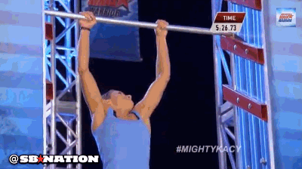
my superheroes:
people who overcome the odds, and those who do the right thing even when no one is watching

Slide 6
are you ready to guess? more details?
-parents divorced, and I rarely speak with my father...it’s been years since we have had meaningful conversation
-I have two older siblings, both with their own families

Slide 7
if you haven’t guessed it yet, a few more hints:
-born on the “left coast”
-I’m old, like really old
-some people think I’m relaxed and low key, but a lot of times I’m the opposite (a work in progress)
-you got it now, don’t you!!!

Slide 8
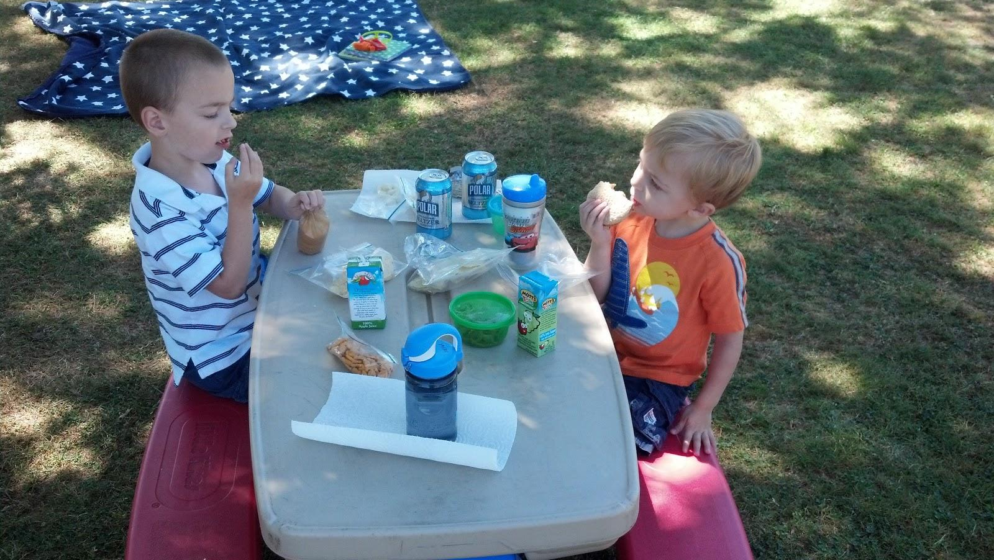
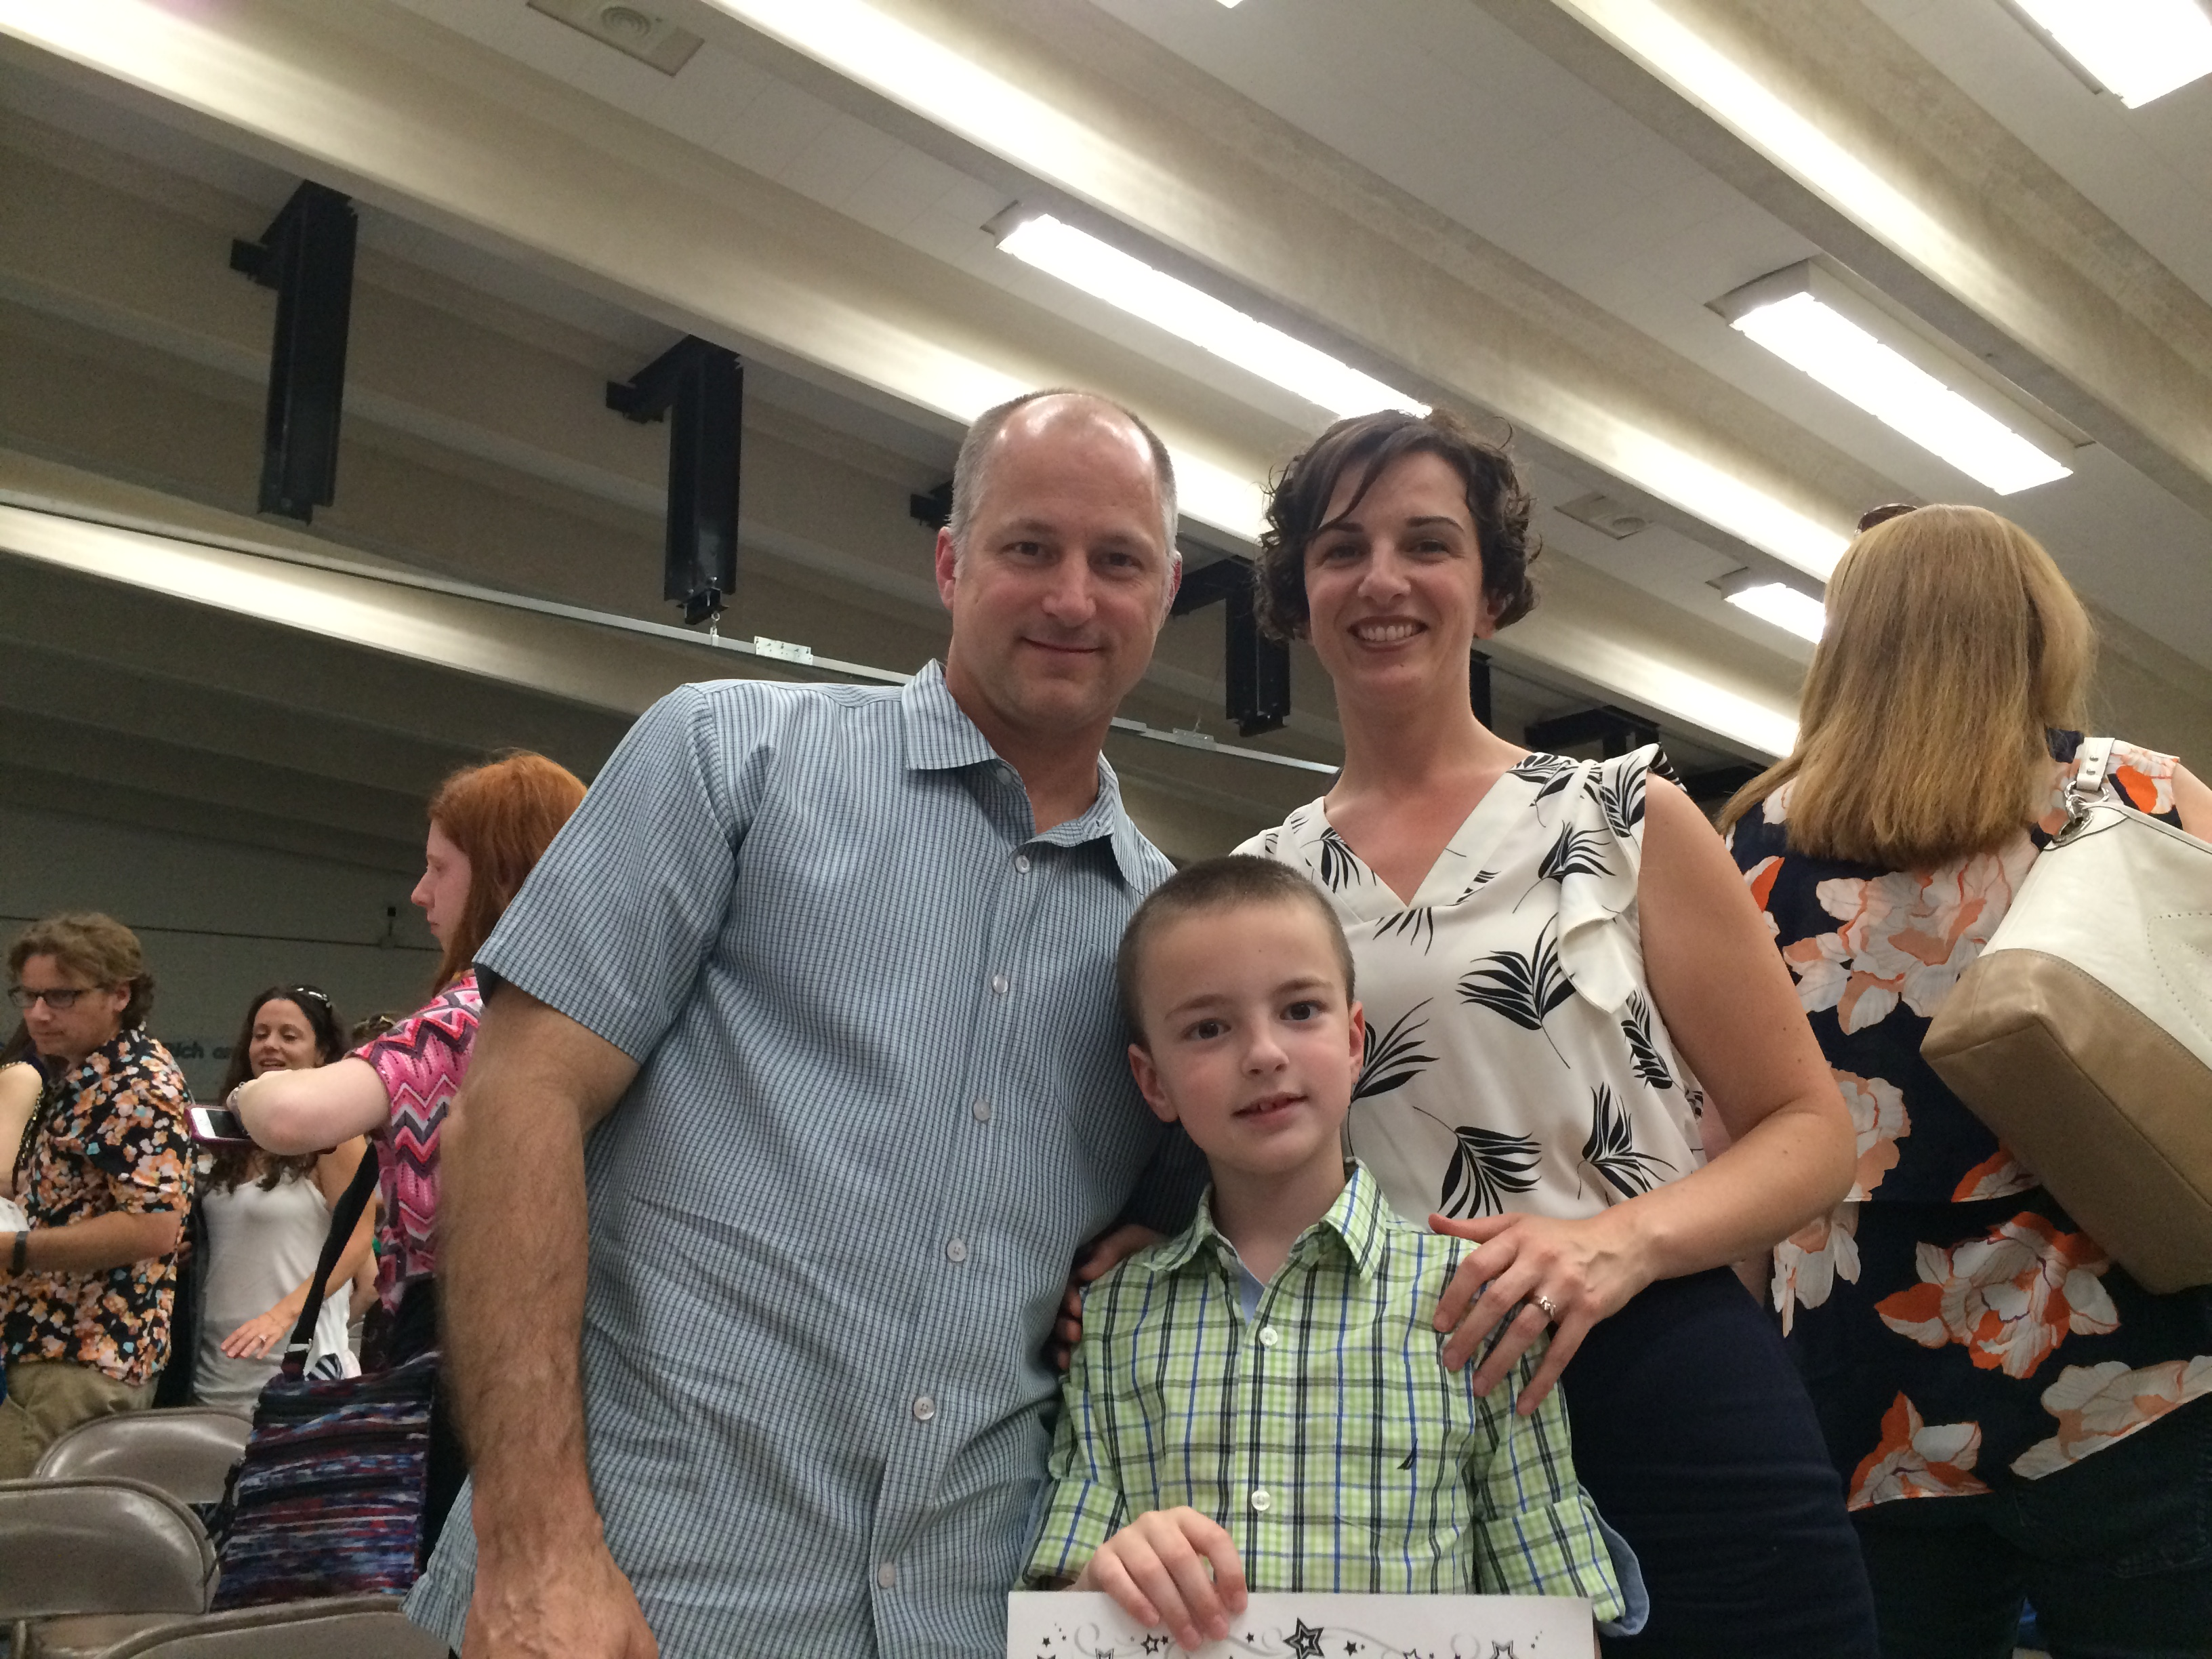
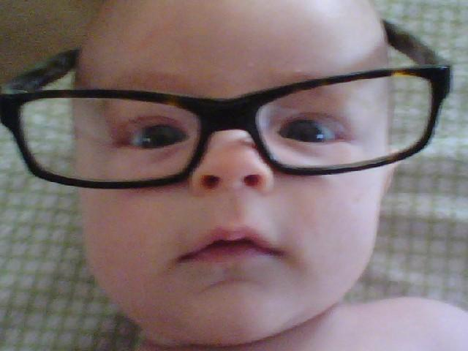
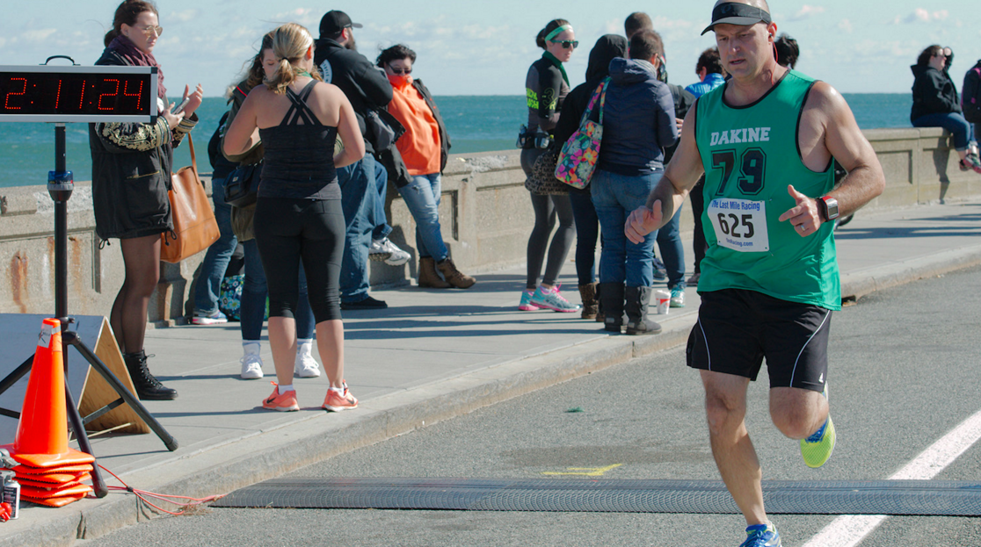

Slide 9
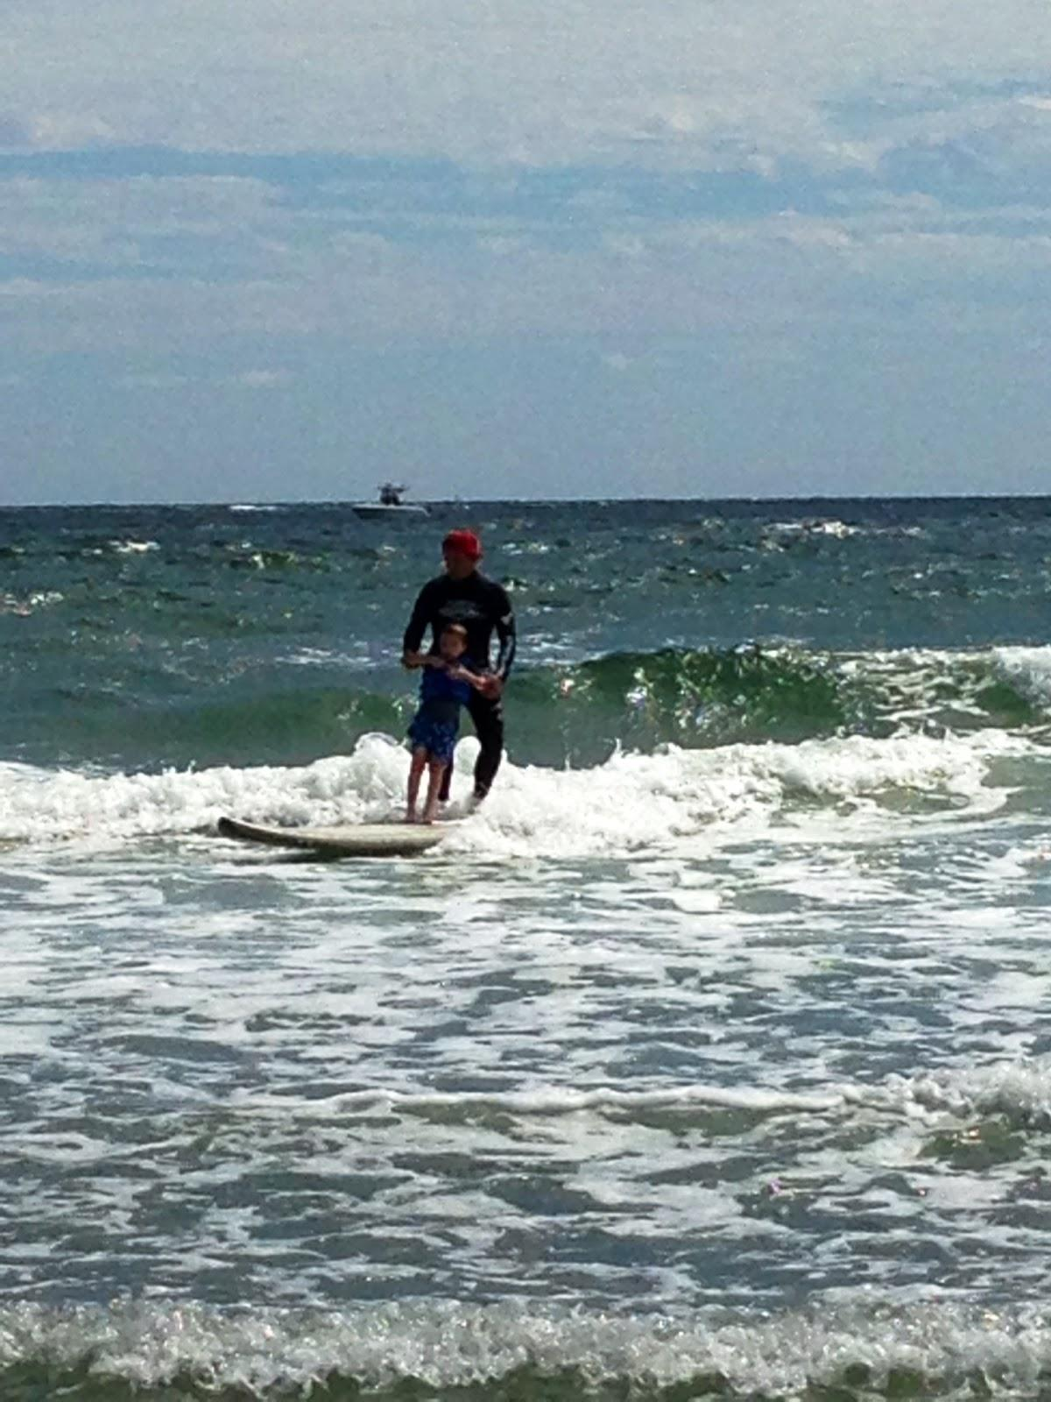
proud daddy...
One of my little guys
taking part in a
program called Surfer’s
Healing in Narragansett

Slide 10
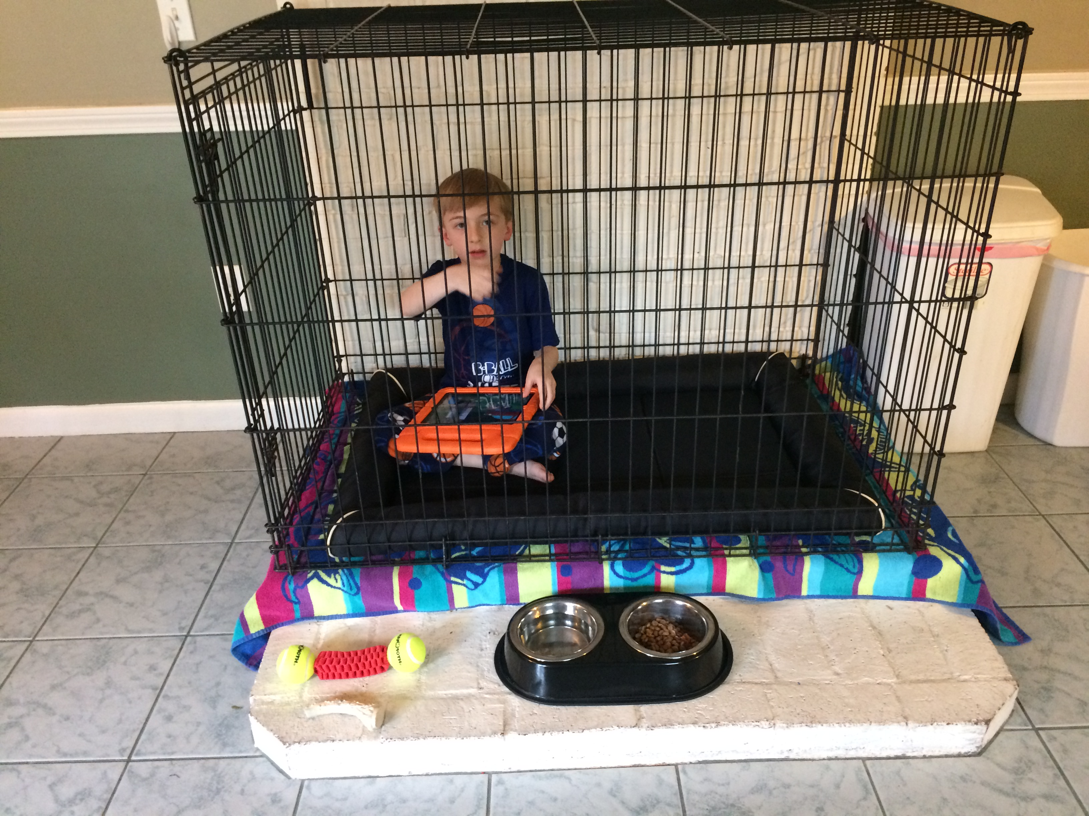
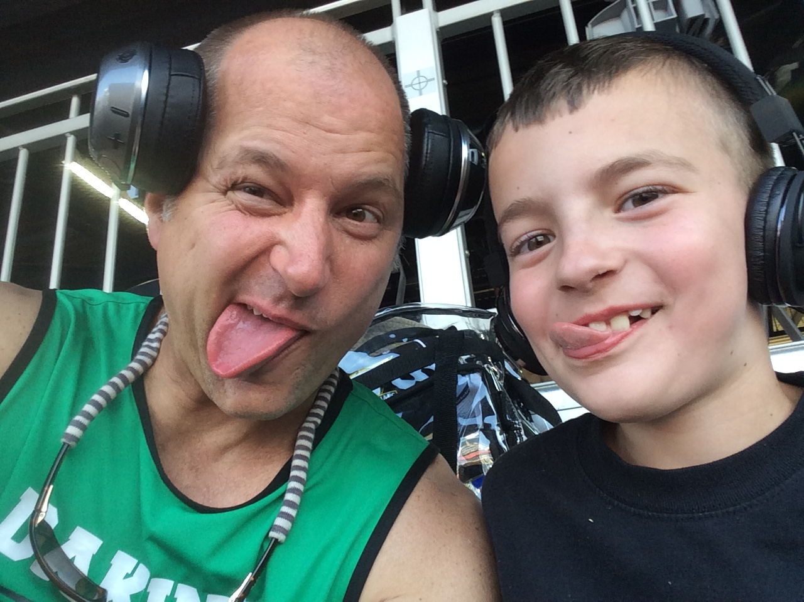
‘da boys…

